Slide 1
2016 State HAHPERD Workshop
Leslie Hicks
SHAPE America Physical Activity Council
Academic Coach
Chandler Unified School District (Arizona)

Slide 2
Arizona
Hawaii

Slide 3
Arizona
SHAPE America

Slide 4
Physical Education Physical Activity Health Education Research
SHAPE America Councils

Slide 5
Our Charge
Review existing programs, products, services and activities in relation to the strategic plan and recommended continuation, revision or elimination
Assess proposal submissions for the SHAPE America convention
Brainstorm potential new programs, products and services
Facilitate the work of SHAPE Task Forces

Slide 6
Physical Education Council
Current Task Force Projects with council liaison
Appropriate Uses of Fitness Measurement (Jayne Greenberg)
User Friendly Standards (Theresa Purcell Cone)
Recess Position Statement (Brian Devore)
Standards Based Grading Progress Report (K. Andrew R. Richard)
Waivers and Exemptions Task Force (Terri Drain)
Student Growth Measures Task Force (Jeana Haag)
Current Task Force Projects with council liaison
Starting an Adapted Physical Education Program FAQ (Kristi Roth)

Slide 7
Hawaii
50 Million Strong by 2029

Slide 9
50 Million Strong
With approximately 50 million students currently enrolled in America’s elementary and secondary schools (grades pre-K to 12), “50 Million Strong by 2029” is SHAPE America’s commitment to empower all children to lead healthy and active lives through effective health and physical education programs. http://www.shapeamerica.org/prodev/50million.cfm

Slide 10
50 Million Strong
In your role as a health and/or physical educator, you are uniquely poised to deliver the benefits of living a physically active and healthy life.
By coming together as a profession, we can solidify public support for health and physical education as benefitting current and future generations.

Slide 11
What’s your number?
How many students do you teach each year?

Slide 12
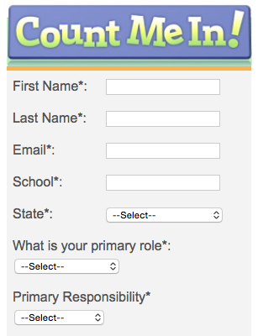
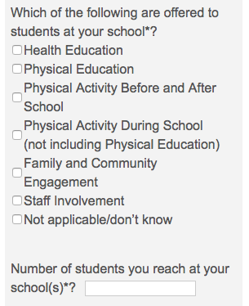

Slide 13
Physical Education Program Checklist
Policy and Environment
Curriculum
Appropriate Instruction
Student Assessment
http://www.shapeamerica.org/standards/guidelines/upload/Physical-Education-Program-Checklist.pdf

Slide 14
Arizona
National Standards for K-12 Physical Education

Slide 15
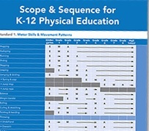
Standards Based Instruction
National Standards & Grade-Level Outcomes for K-12 Physical Education (2014)

Slide 16
National Physical Education Standards
STANDARD 1
The physically literate individual demonstrates competency in a variety of motor skills and movement patterns.
STANDARD 2
The physically literate individual applies knowledge of concepts, principles, strategies and tactics related to movement and performance.

Slide 17
National Physical Education Standards
STANDARD 3
The physically literate individual demonstrates the knowledge and skills to achieve and maintain a health-enhancing level of physical activity and fitness.
STANDARD 4
The physically literate individual exhibits responsible personal and social behavior that respects self and others.

Slide 18
National Physical Education Standards
STANDARD 5
The physically literate individual recognizes the value of physical activity for health, enjoyment, challenge, self-expression and/or social interaction.

Slide 19
Appropriate Instructional Practice Guidelines
Learning Environment
Instruction Strategies
Curriculum
Assessment
Professionalism
http://www.shapeamerica.org/standards/guidelines/upload/Appropriate-Instructional-Practices-Grid.pdf

Slide 20
Learning Environment
Establishing the Learning Environment
Exercise as Punishment
Safety
Diversity
Equity
Inclusion
Competition & Cooperation

Slide 21
Instructional Strategies
Expectations for Student Learning
Class Organization
Class Design
Learning Time
Maximum Participation
Teaching/Learning Styles
Teacher Enthusiasm
Success Rate
Teacher Feedback
Technology Use

Slide 22
Curriculum
Productive Motor Skill Learning Experiences
Concept Knowledge
Regular Participation
Developing Health-Related Fitness
Self-Responsibility & Social Skills
Valuing Physical Activity
Interdisciplinary Instruction
Special Events

Slide 23
Example
Appropriate Practice
Inappropriate Practice
Teachers adapt their lessons for different classes within and between grade levels.
Teachers design progressions that allow students to build on previously learned content and skills by focusing on lifetime activities.
Teachers design progressions that allow students to build on previously learned content and skills, by focusing on lifetime activities.
The same lesson plans and activities are used for all grade levels.
Teachers teach all students the same skills year after year. Activities are the same for all grade levels.
The same games and activities are used for all grade levels through- out the year.

Slide 24
Assessment
Assessment Use
Variety of Assessments
Fitness Testing
Testing Procedures
Reporting Student Progress
Grading
Program Assessment

Slide 25
Professionalism
Professional Growth
Professional Learning Community
Advocacy

Slide 26
Essential Components of Physical Education
4 Essential Components
Policy and Environment
Curriculum Appropriate Instruction
Student Assessment
http://www.shapeamerica.org/explorepe.cfm

Slide 27
Hawaii
CSPAP

Slide 28
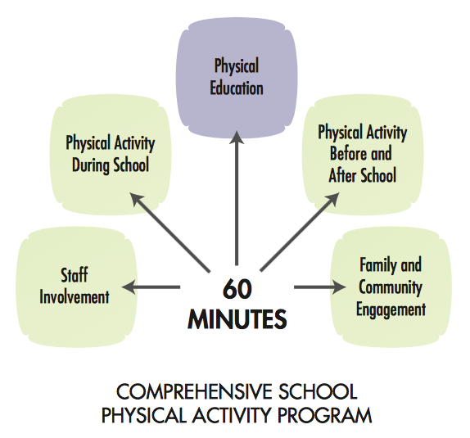
Comprehensive School Physical Activity Program

Slide 29
Let’s Move! Active Schools

Slide 30
Let’s Move! Active Schools
http://www.letsmoveschools.org

Slide 31
Let’s Move! Active Schools
Evaluate. How is your school moving?
The assessment tool will help you see where you already shine and where you need to step it up.

Slide 32
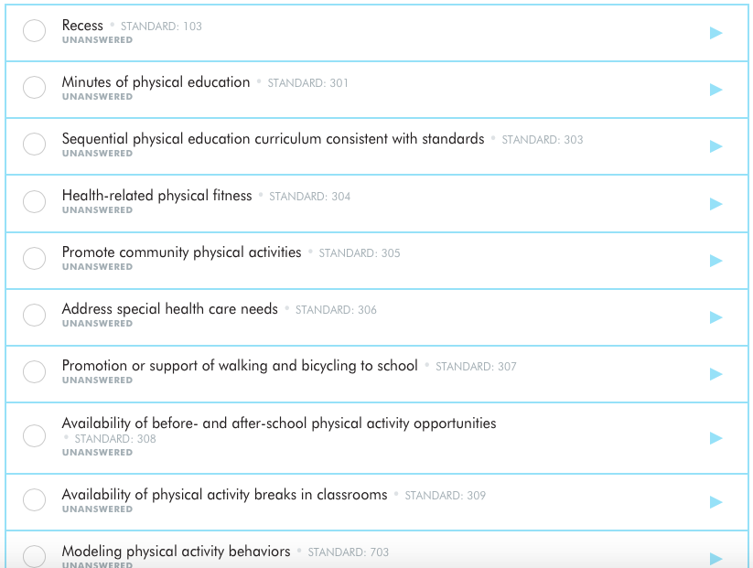
Let’s Move! Active Schools

Slide 33
Arizona
What’s on your to do list?
ESSA

Slide 34
Every Student Succeeds Act

Slide 35
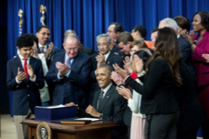
Every Student Succeeds Act
The U.S. Congress passed the Every Student Succeeds Act (ESSA) in December 2015, reauthorizing the Elementary and Secondary Education Act (ESEA) of 1965.
President Obama signed the bill into law on December 10.

Slide 36
Basics of ESSA
Government Authority
the goal was to strike the right balance between the respective roles of federal, state and local governments in formulating education policy.
Standards and Assessments
States must still adopt challenging standards for academic subjects.
Teacher Requirements
Teacher and Principal Evaluation
Core Subjects vs. Well-Rounded Education
Consolidation of Programs

Slide 37
Basics of ESSA
Teacher Requirements
States have the authority to set their own teacher requirements and licensure standards.
Teacher and Principal Evaluation
States and school districts must develop and implement teacher and principal evaluation systems that are based in part on evidence of student achievement.
Core Subjects vs. Well-Rounded Education
Consolidation of Programs

Slide 38
Basics of ESSA
Core Subjects vs. Well-Rounded Education
While school health and physical education were not included in No Child Left Behind – which led to restricted access to program funding – they are included in the ESSA definition of well-rounded education.
Consolidation of Programs
Programs have been consolidated in ESSA into a large block grant of funds that will be distributed to states.

Slide 39
Basics of ESSA
School health and physical education are identified as part of a student’s “well-rounded” education. The term “well-rounded education” replaces the term “core subjects” used in previous authorizations of the Elementary and Secondary Education Act.
Being part of the definition of a well-rounded education puts school health and physical education on a level playing field with other academic subjects.

Slide 40
Basics of ESSA
School districts will be able to access funding from Title I, Title II and Title IV through their state department of education. The process for accessing these funds is still being developed by the Department of Education with oversight from Congress.

Slide 41
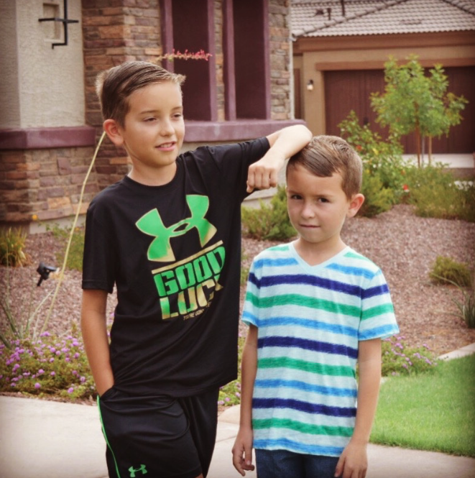
Every Student Succeeds

